Slide 1
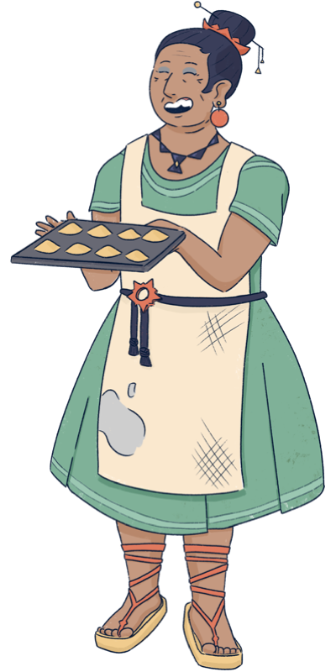
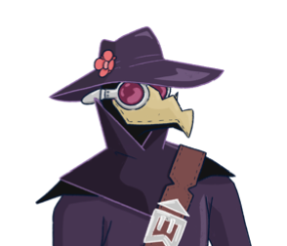
You must be the new doctor! I have been waiting for you…
Sorry ma’am, you must mistake me for my old grandpa.
I am wearing the same outfit, and I have his old manual,
but I have no experience, no way I can help you.
Also, I plan to be in town only for one week,
I do not have time for this…
It is impossible to recognize you, with that mask…
I am sure you are as talented as the old doctor!
Please help me, we have plenty of time today.
And as a reward, I will make you try my new recipe.
I baked delicious broccoli cookies!

Slide 2
DAY 1 – TUTORIAL PAGE 1
EXPLAIN THE BUTTONS

Slide 3
DAY 1 – TUTORIAL PAGE 2
EXPLAIN THE TESTS

Slide 4
DAY 1 – TUTORIAL PAGE 3
EXPLAIN THE MANUAL AND MEDICINES

Slide 5
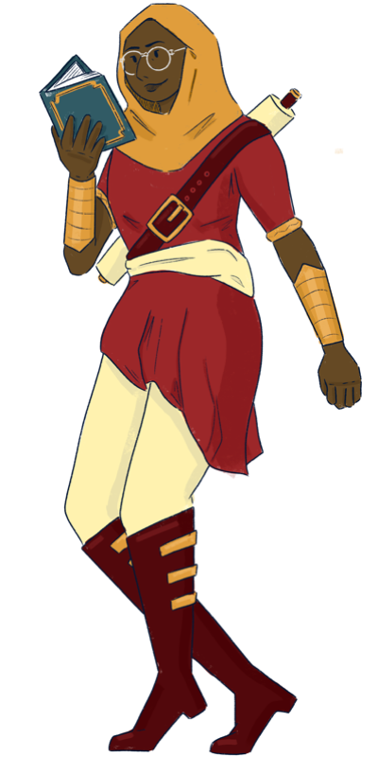
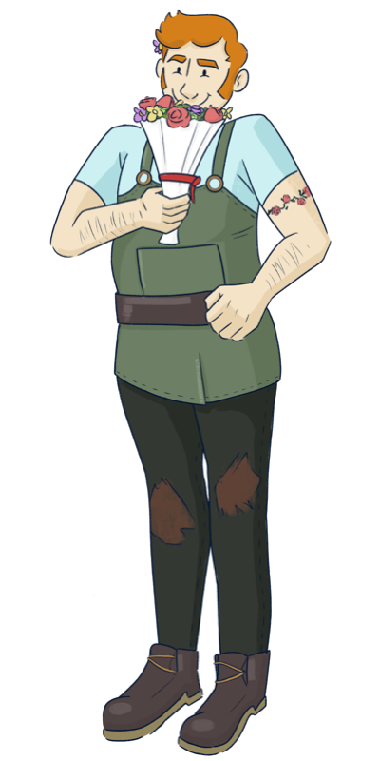
So… you are the “young doctor.”
The village is small, and Bella told everyone about you
(and also about the broccoli cookie, blah!)
I guess you can help me, I found not help in this book…
I guess I am doomed! What a terrible vacation.
I have only a few days left in the village,
I wonder how desperate they are to ask help to me…
Sorry to bother you, but I am also in need for help.
Please, we really need you. Everyone in the village
is happy to help each other, we will not forget this!

Slide 6
DAY 2 – TUTORIAL PAGE 1
EXPLAIN THAT YOU CAN GET EXPERIENCE AND USE IT TO IMPROVE SKILLS AND BE MORE ACCURATE
FROM NOW ON YOU HAVE FEWER TESTS AVAILABLE EACH DAY
CHOOSE CAREFULLY THE TEST TO USE

Slide 7
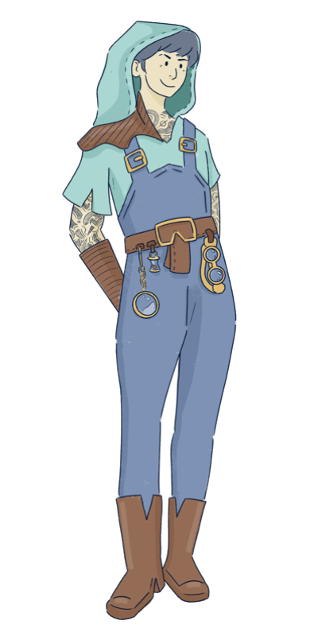
After you helped me the other day, I felt much better.
Then I ate some burned cookies, and here I am again…
You should know me by now, finding the cure will be easy!
It could be something completely different from before!
But yes, it is true it will take less time.
It seems you have time to spare…
In that case, better help me, doctor.
My case might be trickier, but the reward will be higher!

Slide 8
DAY 3 – TUTORIAL PAGE 1
EXPLAIN THAT RECURRENT PATIENTS ARE EASIER TO CURE (SOME SYMPTOMS ARE ALREADY REVEALED) BUT GIVE LESS EXPERIENCE

Slide 9
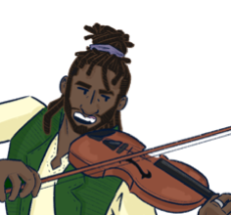
You are something! I heard that people are travelling
from other villages to get your help…
But what is this terrible noise I hear from the forest?
I cannot read!
Good grief, even MORE patients???
This sound is terrifying, what kind of animal is in pain?
It is me, Bob!
I usually travel to spread my music with the world,
but today I am here only to beg for your help.
I will convince you… by playing an original piece!

Slide 10
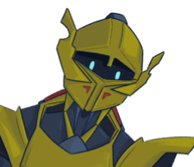
Who am I?
Who are you?
Where am I going?
Where do I come from?
Are you a knight or a Greek philosopher?
I am lost, and I do not remember anything.
Maybe… maybe you can help me?

Slide 11
My memories are back, but I need to rest a few days more before going back to my kingdom. This village seems the perfect place to rest, so quiet…
Definitely not for me! My “relaxing” week is almost over and I have been working all the time (and for free)
Don’t be grumpy, doc!
I can tell you are a completely different person.
You’ve mastered almost all the tricks in that dusty manual…

Slide 12
THANK YOU SO MUCH!!!
We know this is the your last day in town.
Time for the last check-up visits,
and then PARTY TIME!
OK OK, but I still need to pack all my stuff,
I do not have much time!
(They are so needy, but I will miss them)
So don’t waste any time, doc!
My delicious cake in waiting in the oven,
I do not want to burn it (again)

Slide 14
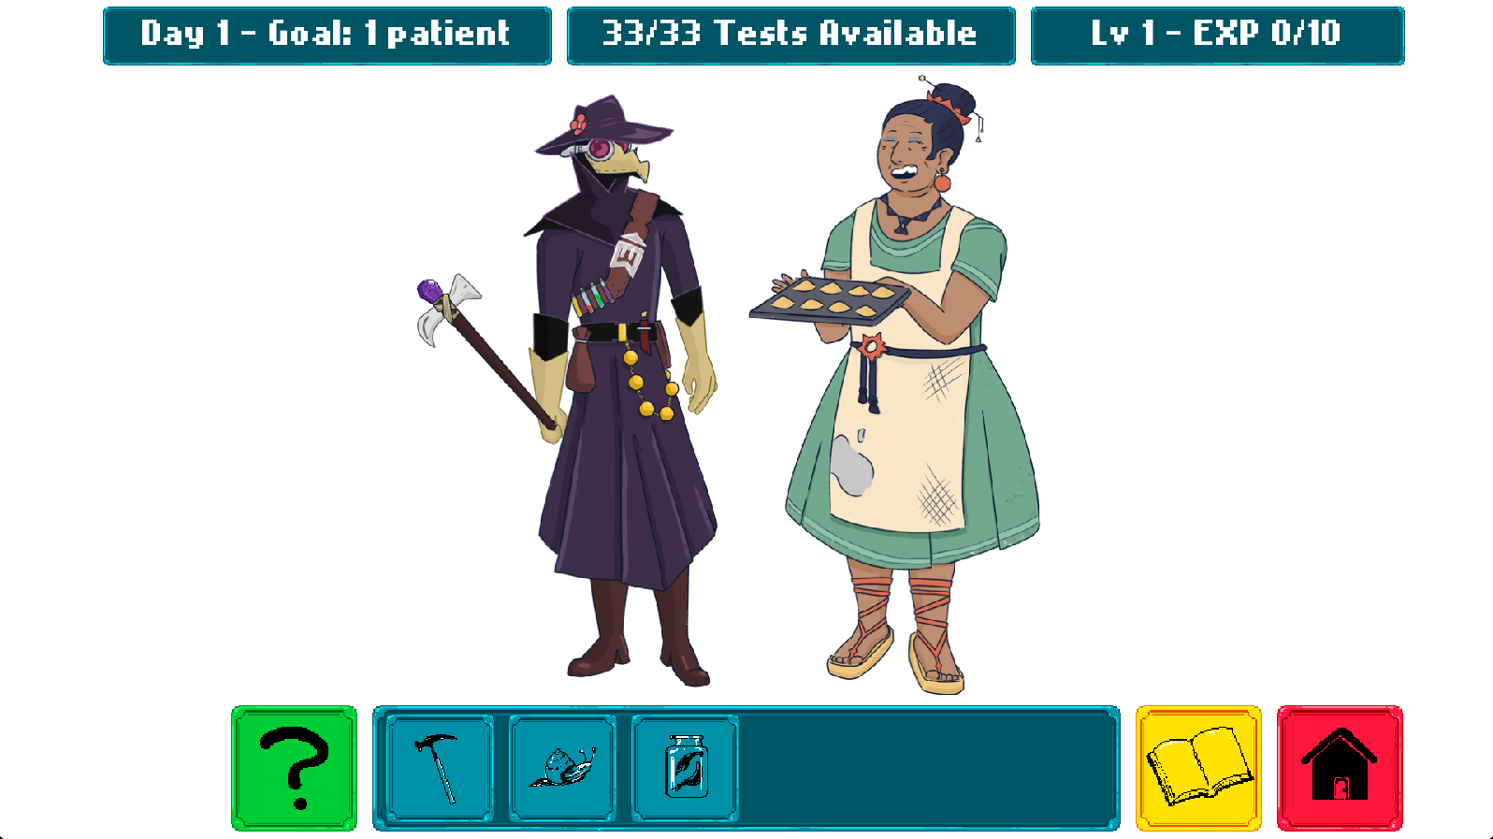

Slide 17

1. Visit the Patients
Each day some villagers seek your help
Sometimes some symptoms are immediately visible, but usually you are not sure
You can run tests (blue icons) to learn more about their symptoms
Click on a patient to read their report (list of symptoms), then click on the test icons to update the report with the new results
Your tests are initially not perfect, you will have the chance to improve them later
You have a limited number of tests available every day
To move to another patient, return to the main screen (red icon)

Slide 18
2. Consult the Manual
Click on the manual (yellow icon) to see the list of known diseases
You unlock more diseases and symptoms during the game
Each disease has a typical pattern of symptoms
Some of them always appear in the sick patients, others never appear, and others might appear with different likelihood (rarely or often)
Consult the manual to decide which tests are most useful for your diagnosis
The manual also contains the correct medicine for each disease
Chamomile has a small chance of cure any disease (it is not very reliable)

Slide 19
3. Cure the Patients
When you have collected enough hints, it’s time to cure you patients
From the report page of a patient, click the Medicines icon (above the villager)
You can choose one medical herb and assign it to the patient
You find the correct treatment for each disease in the manual
After you choose a medicine for each patient, a confirmation button (green) will appear on the bottom-left corner of the screen. Click it to end the day
You will see the report with information about which patients are cured

Slide 20
4. Experience and Days Progression
In order to proceed, you need to cure at least the target number of patients
If you fail, you will restart the day
If you succeed, you also collect experience based on which patient you saved. Each patient has a different experience value
Experience points make you advance to the next level and unlock new skills
You can use the skill points to improve the accuracy of your test
A test with higher accuracy makes fewer mistakes

Slide 21



Slide 25
VISIT THE PATIENTS
Each day some patients seek your help
Sometimes their symptoms are visible, other times you cannot be sure
You can run tests (blue icons) to learn more about their symptoms
Click on a patient to read their report, then click on the test icons to update the report with the new results
Your tests are not perfect, you can improve them during the game
You have a limited number of tests available every day
Click on the red icon (home) to return to the main screen

Slide 26
CONSULT THE MANUAL
Click on the manual (yellow icon) to see the list of known diseases
You unlock more diseases and symptoms during the game
Each disease has a typical pattern of symptoms. Some of them always appear in the sick patients, others never appear, and others might appear with different likelihood
Make sure you consult the manual to decide which tests are most useful for your diagnosis
The manual also contains the suggested treatment for each disease

Slide 27
TREAT THE PATIENTS
When you run out of tests, it’s time to treat you patients
Click on a patient to open the report page
You cannot run tests anymore, but you can assign a treatment to each patient
Click on the right column to assign a medicinal herb
You find the correct treatment for each disease in the manual
After you choose a treatment for each patient, the day is over
You will see the report with information about which patients are healed

Slide 28
EXPERIENCE AND DAYS PROGRESSION
In order to proceed to the next day, you need to save at least the target number of patients
If you fail, you will restart the day
If you succeed, you also collect experience based on which patient you saved. Each patient has a different experience value
Experience points make you advance to the next level and unlock new skills
You can use the skill points to improve the accuracy of your test
A test with higher accuracy makes fewer mistakes

